Slide 1


Slide 2


Slide 3
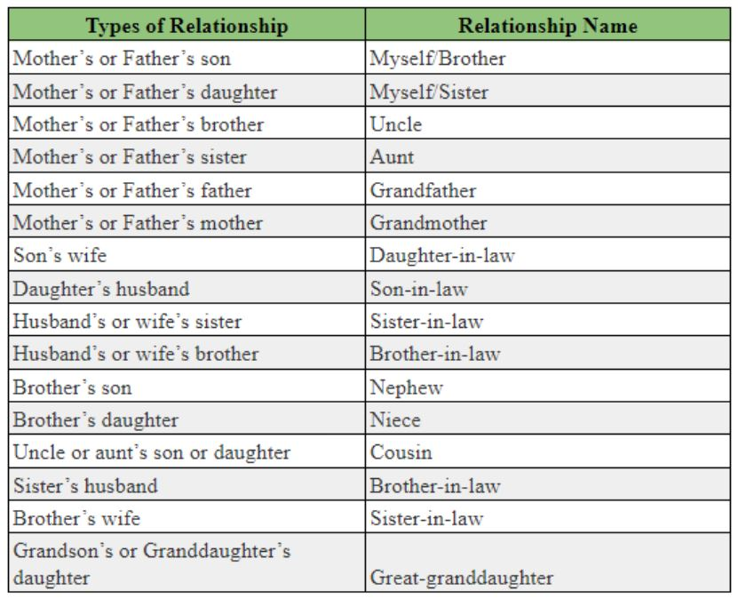

Slide 4
Pointing to Kapil, Shilpa said, "His mother's brother is the father of my son Ashish." How is Kapil related to Shilpa ?
(a) Sister-in-law (b) Nephew
(c) Niece (d) Aunt

Slide 5
Pointing to a photograph, a person tells his friend, "She is the grand daughter of the elder brother of my father." How is the girl in the photograph related to this man?
(a) Niece (b) Sister
(c) Aunt (d) Sister-in-law

Slide 6
Pointing to a photograph, a lady tells
Pramod,
“ I am the only daughter of this lady
and her son is your maternal uncle."
How is the speaker relate to
Pramod’s father ?
(a) Sister-in-law (b) Wife
(c) Either (a) or (b) (d) Neither (a) nor (b)

Slide 7
Pointing to a photograph, a woman says, "This man's son's sister is my mother-in-law." How is the woman's husband related, to the man in the photograph?
(a) Grandson (b) Nephew
(c) Son (d) Son-in-law

Slide 8
(5) Given that
1. A is the mother of B;
2. C is the son of A;
3. D is the brother of E;
4. E is the daughter of B .
The grandmother of D is :
(a) A (b) B
(c) C (d) E

Slide 9
I. F is the brother of A.
II. C is the daughter of A.
III. K is the sister of F,
IV. G is the brother of C.
Who is the uncle of G ?
(a) A (b) C
(c) F (d) K

Slide 10
Directions (Questions 7 to 8): Read the following information and answer the questions given below it :
‘A + B’ means 'A is the daughter of B’ ;
‘A × B’ means 'A is the son of B’;
‘A – B’ means A is the wife of B’.
(8) If T - S × B - M , which of the following is not true?
(a) B is mother of S.
(b) M is husband of B
(c) T is wife of S.
(d) S is daughter of B
(7). If P × Q - S ,which of the following is true?
(a) S is wife of Q (b) s is father of P.
(c) P is daughter of Q. (d) Q is father of P.

Slide 11
(9) A,B, C, D, E, F and G are the members of a
family. Out of them, four are adults and
three are children, of which two, F and G
are girls. A and D are brothers and A is a
Doctor. E is an Engineer and has married
one of the two brothers. E has two
children. B is married to D and G is their
child. Then who is C ?
(a) Daughter of E (b) Son of A
(c) Father of F (d) Brother of G

Slide 12
(10) Choose the option that describes correctly
sufficiency of information “I” and “II” for answering
the question, "How is M related to R ?
(I) ‘A's brother, F, who is the only son of his parents,
is married to W, who is M’s sister.
(II) W and F have a only daughter R.
(a) "a" alone is sufficient
(b) Both "a" and "b" are sufficient
(c) Either "a" or "b" is sufficient
(d) Neither "a" nor "b" is sufficient

Slide 13
(11) Ali is brother of Bala . Kallu is father
of Ali. Damu is brother of Nila. Nila is
daughter of Bala. Then select the
option that indicates Damu's paternal
uncle.
(a) Ali
(b) Kallu
(c) Bala
(d) One needs to know Bala’s gender

Slide 14
(12) Study the information and relationship given and select the
option that shows it .
x ÷ y represents that x is the mother of y .
x - y represents that x is the brother of y .
x + y represents that x is the sister of y .
x x y represents that x is the daughter of y .
m + n – o x p ÷ q
(1) All persons are siblings.
(2) m, n, o, q are the children of p.
(3) m, n, o are the children of p and q.
(4) m, n, o, p are the children of q.

Slide 15
(13) If A $ B means A is the father of B;
A # B means A is the sister of B ;
A * B means A is the daughter of B ;
A @ B means A is the brother of B,
then select the relation chain that indicates R, T
and M are siblings ?
(1) Q $ R @ T * M
(2) Q @ R $ T # M
(3) Q $ R * T # M
(4) Q $ R @ T # M

Slide 16
(14) If A + B means, A is brother of B .
A x B means, A is husband of B .
A %B means, A is mother of B .
A - B means, A is sister of B .
Then which of the following statements insist
that T is son of P ?
(a) P x Q + R % S – T
(b) P + Q % R – T x S
(c) P x Q % R x T – S
(4) P x Q % R - T + S

Slide 17
(15) If A $ B means A is the brother of B;
A @ B means A is the wife of B ;
A # B means A is the daughter of B
A * B means A is the father of B,
then select the relation chain that indicates W, T
and Q are siblings.
(a) P @ Q $ W * T # U
(b) P @ W $ Q * T # U
(c) P @ Q $ T # U * W
(d) P @ Q $ T # W * U

Slide 18


